Slide 1

CSE 163
Memory Management
Hunter Schafer

Slide 2
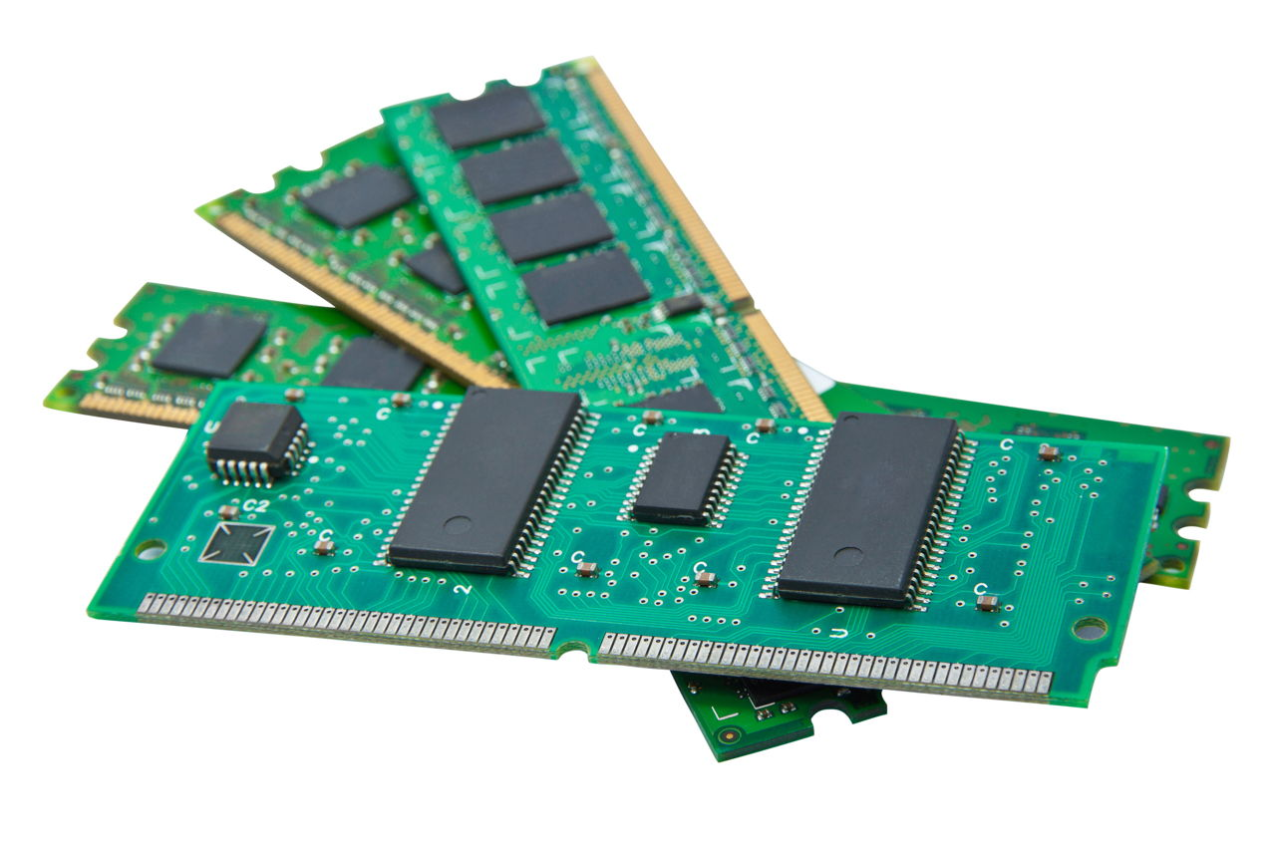
Memory

Slide 3
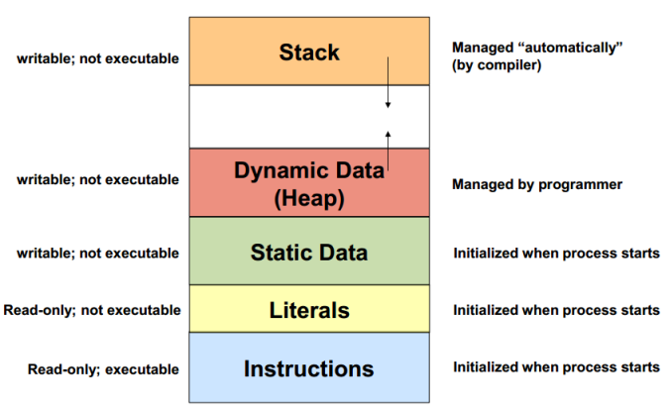
Memory
Names not important

Slide 4
Objects
Data and objects are just chunks of memory
When you construct an object, the computer gives you an appropriately sized chunk of memory
The fields are just specific locations within a chunk to store data
This is why we need the difference between equality of value and equality of identity
Equal value: memory chunks store the same values
Equal identity: same chunk of memory
By creating objects, you are making your program use more memory

Slide 5
Creating Objects
VS Code
Every time an object is created, it takes up a bit of memory
This can build up over time
If an object is not referenced, it will get garbage collected.
Natural question, who would ever create this many objects?
You did on HW4!
Using pickle to store object in a file

Slide 6
Memory Hierarchy
The memory we have been talking about is volatile memory
If you shut your computer down, it all disappears
It’s great because it’s relatively fast and can store a moderate amount of data (~16GB)
However it’s not the fastest nor can it store the most data

Slide 7
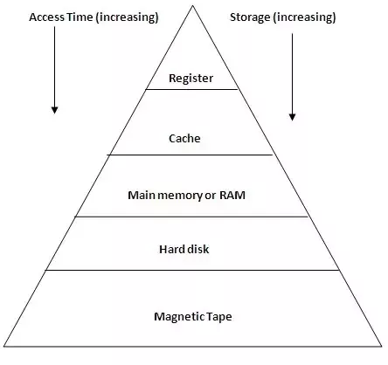
Memory Hierarchy

Slide 8
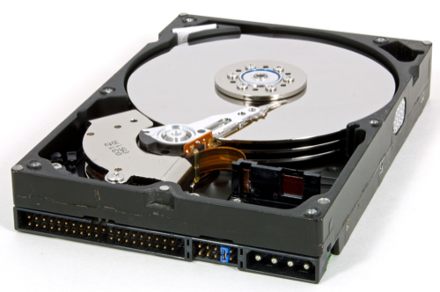
Disk Drive

Slide 9
Paging
When working with big data, it might be the case that your data doesn’t fit in memory
In this case, your computer will send big chunks of memory to disk until it’s needed later
This can cause huge slow downs in your program since reading/writing to disk is generally slow

Slide 10
General Takeaways
Don’t store references to data you don’t need
Restrict global variables
Keep things local
Don’t iterate through data in random order
When developing, use a small random sample of your data so you don’t have to work with the whole thing.

